Slide 1
SPA© Strategies for More Success
With Less Stress:
Learn to LOVE Learning!
Hettie P. Johnson, M.A., CCC-SLP
Hoover, AL
hettiej@gmail.com www.hettiejohnson.com
This is a video of my talk from IDA-AL in 2018:
Video of SPA talk October 2018:
SPA Strategies for More Success With Less Stress
Copyright 2016 Hettie P. Johnson

Slide 2
SPA Strategies for More Success With Less Stress:
Learn to LOVE Learning
The Power of “YES!”
IDA-AL Conference University of Mobile
October 19, 2018
Hettie P. Johnson, M.A., CCC-SLP Hoover, AL
hettiej@gmail.com www.hettiejohnson.com
https://tinyurl.com/happyamygdala
https://tinyurl.com/SPAHappyAmygdala
Copyright 2016 Hettie P. Johnson

Slide 3
Hettie Johnson and Chloé Bourgeois are both in private practice and have no relevant financial or nonfinancial conflicts to disclose.

Slide 4
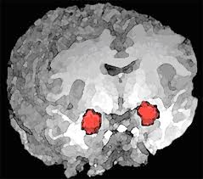
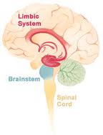
SPA
Self-talk
Positive Mistake Correction
Advocate for yourself
Copyright 2016 Hettie P. Johnson

Slide 5
SPA
A key to help anyone avoid fight, flight, or freeze
Shows students they have the power to improve their brain and learning
Facilitates positive self talk
Multisensory strategies connect joy with learning and lead to love of learning
Proverbs 16:24 Pleasant words are a honeycomb, sweet to the soul and healing to the bones. vs. Proverbs 12:18 Reckless words pierce like a sword.

Slide 6
Parent Reports
“It’s as if the weight of the world was lifted off his shoulders.” (age 6)
“The strategies you taught us last year have saved my son’s academic career.” (age 9)
UA student: Low Fs to straight As (age 19)
“I will always say you saved my daughter from massive depression and helped her get back on track.” (age 13 with high anxiety and trichotillomania)
I think this will help him well beyond his concussion. (age 16)
He is doing great! He has really slowed down his speaking and was moved to the highest reading group. (age 11 with Asperger’s)
Thank you so much for your time the other day. It has already made an impact on her. She made a B on her Biology quiz where she was usually making an F. (age 14)

Slide 7
Parent Reports
“It’s as if the weight of the world was lifted off his shoulders.” (age 6)
“The strategies you taught us last year have saved my son’s academic career.” (age 9)
UA student: Low Fs to straight As (age 19)
“I will always say you saved my daughter from massive depression and helped her get back on track.” (age 13 with high anxiety and trichotillomania)
Thank you. It has already made an impact on her. She made a B on her Biology quiz where she was usually making an F. (age 14)

Slide 8
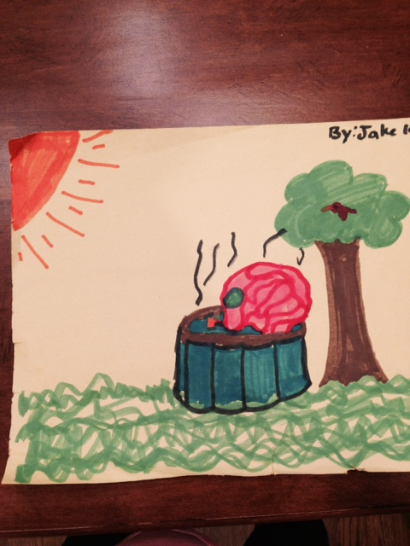

Slide 9
SPA
Gives a concrete, explicit strategy to avoid fight, flight, or freeze
Shows students they have the power to improve their brain and learning
Facilitates positive self talk
Multisensory strategies connect joy with learning and lead to love of learning
Pleasant words are a honeycomb, sweet to the soul and healing to the bones.

Slide 10
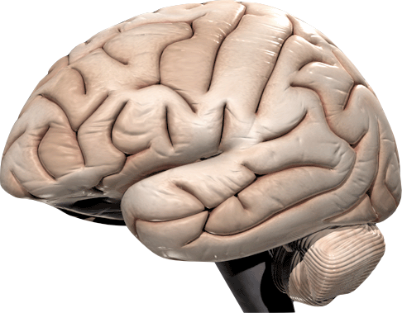
Multisensory
SWAG
Study With All Gears
CEO of your brain
Thinking, Learning, Self-Control…
Touching and Moving
Seeing
Hearing and Talking
Hebb’s Law: Neurons that fire together, wire together.
Orton, S 1925; Gillingham & Stillman, 1936

Slide 11
Multisensory
SWAG
Study With All Gears
Samuel Orton, 1925; Anna Gillingham & Bessie Stillman, 1936
CEO of your brain
Thinking, Learning, Self-Control…
Touching and Moving
Tactile-Kinesthetic
Auditory
Visual
Multisensory Triangle
Seeing
Hearing and Talking
Tou
Hebb’s Law: Neurons that fire together, wire together.

Slide 12
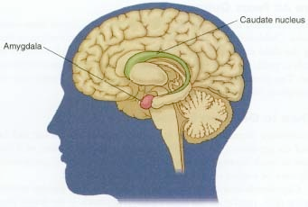
Guardian of Your Learning Brain
Your Amygdala
Shuts down your learning brain if anxious, bored, frustrated - “Like putting a stop sign in your brain”
Fight, flight, or freeze
It’s your job to keep your amygdala happy!
Judy Willis, M.D., Learning to LOVE Math, 2010

Slide 13
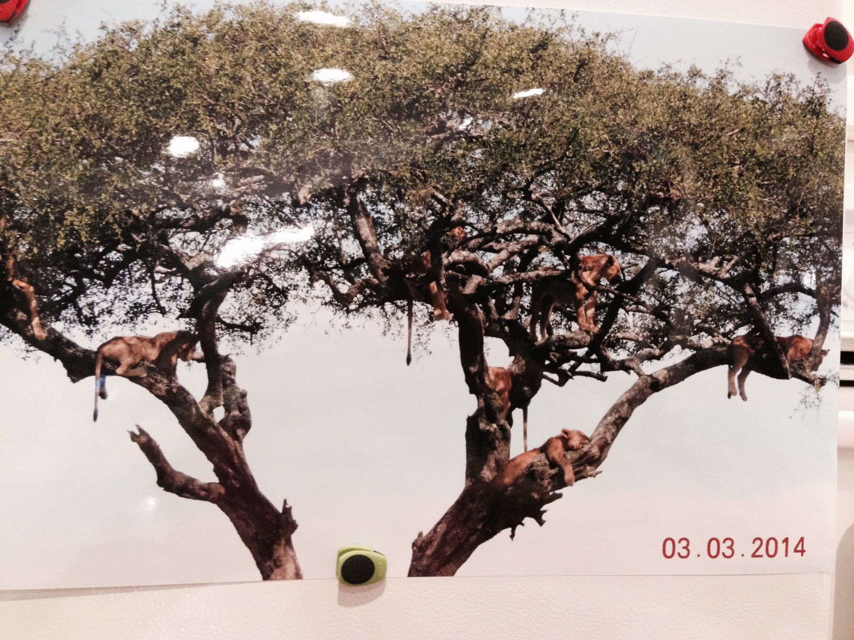
Fight, flight, or freeze
TT

Slide 14
Amygdala
An emotional filter that guards your learning brain - “switching station”
If your amygdala feels safe, it sends information and increased blood flow to your thinking brain plus releases dopamine that increases memory and floods the brain with joy.
If your amygdala senses danger, it increases blood flow to fight, flight, or freeze and floods your brain with stress.
It’s your job to keep your amygdala happy!
Multisensory learning also increases dopamine.
Judy Willis, M.D., Learning to LOVE Math, 2010

Slide 15
Lose-Lose!
If your amygdala feels overwhelmed:
Goes into survival mode
Decreases blood flow to thinking and increases it to fight/flight/freeze
Releases stress neurotransmitters such as CORTISOL and negative feelings take control
Judy Willis, M.D., Learning to LOVE Math, 2010
Notes:
GOAL is to keep your RAS filter open to to the info you want to enter your PFC. The difference is being (reflective) IN CONTROL OF or CONTROLLED BY outside influences (reactive). You can strengthen your ability to choose the way your brain senses things around you by FOCUSING, PRACTICING SELF-OBSERVATION, AND RECOGNIZING HOW YOUR EFFORT INFLUENCES YOUR ABILITY TO REACH YOUR GOALS. If you make the decision to review and practice what you learn, you grow the parts of your brain that make your memories permanent.

Slide 16
Win-Win!
If your amygdala feels safe:
Sends information to your thinking brain, so you can learn and be in control (-:
Adds DOPAMINE - a “memory chip” - to help you learn and remember more
SWAG increases dopamine (-:
Judy Willis, M.D., Learning to LOVE Math, 2010
Notes:
GOAL is to keep your RAS filter open to the info you want to enter your PFC. The difference is being (reflective) IN CONTROL OF or CONTROLLED BY outside influences (reactive). You can strengthen your ability to choose the way your brain senses things around you by FOCUSING, PRACTICING SELF-OBSERVATION, AND RECOGNIZING HOW YOUR EFFORT INFLUENCES YOUR ABILITY TO REACH YOUR GOALS. If you make the decision to review and practice what you learn, you grow the parts of your brain that make your memories permanent.

Slide 17
Multisensory
SWAG
Study With All Gears
Prefrontal Cortex PFC
Thinking, Learning, Self-Control…
Touching and Moving
Seeing
Hearing
Tou
Orton, S 1925; Gillingham & Stillman, 1936

Slide 18
Lose-Lose
If your amygdala feels threatened, it:
Decreases blood flow to thinking and increases it to fight, flight, or freeze
Floods your brain with stress
Win-Win
If your amygdala feels safe, it:
Increases blood flow to your thinking brain
Adds DOPAMINE, a “memory chip” that improves motivation, focus, and helps you love learning
Multisensory learning increases dopamine and joy (-:
Judy Willis, M.D., 2010
Notes:
GOAL is to keep your RAS filter open to to the info you want to enter your PFC. The difference is being (reflective) IN CONTROL OF or CONTROLLED BY outside influences (reactive). You can strengthen your ability to choose the way your brain senses things around you by FOCUSING, PRACTICING SELF-OBSERVATION, AND RECOGNIZING HOW YOUR EFFORT INFLUENCES YOUR ABILITY TO REACH YOUR GOALS. If you make the decision to review and practice what you learn, you grow the parts of your brain that make your memories permanent.

Slide 19
SWAG
“Study With All Gears”
Frontal Lobes Prefrontal Cortex
CEO of your brain
Parietal Lobes
Tactile-Kinesthetic Touching and Moving
Occipital Lobes
Visual
Seeing
Temporal Lobes
Auditory-Verbal Hearing and Talking
Orton, 1925; Gillingham & Stillman, 1936

Slide 21
TT

Slide 22
Some Benefits of Increased Dopamine
Increases satisfaction and pleasure
Adds a “memory chip” for your brain
Increases other neurotransmitters to improve attention, memory, and motivation
Helps you love learning
Helps YOU be in charge instead of fight, flight, or freeze
Judy Willis, M.D., 2010
Notes:
GOAL is to keep your RAS filter open to to the info you want to enter your PFC. The difference is being (reflective) IN CONTROL OF or CONTROLLED BY outside influences (reactive). You can strengthen your ability to choose the way your brain senses things around you by FOCUSING, PRACTICING SELF-OBSERVATION, AND RECOGNIZING HOW YOUR EFFORT INFLUENCES YOUR ABILITY TO REACH YOUR GOALS. If you make the decision to review and practice what you learn, you grow the parts of your brain that make your memories permanent.

Slide 23
Self-Talk
Tell your brain what you WANT to happen — in present tense. Your brain believes you and acts on what you tell it.
I’m GOOD at this!
I’m just having trouble. I can DO this!
I LOVE this!
Say to the negative voice, “Stop it brain! You can’t shut me down. I can DO this!”

Slide 24
Positive Mistake Correction
Student
Be kind to yourself. YOU are in the driver’s seat of your brain.
Show your amygdala ONLY what you got RIGHT.
I got THIS part RIGHT - Now I’ll get THAT part!
I learned from that! I’ll do better next time!
Dyson vacuum cleaner - 5 years and 5,127 prototypes
Proverbs 16:23-24 A wise man’s heart guides his mouth and his lips promote instruction. Pleasant words are a honeycomb, sweet to the soul and healing to the bones.
Notes:
Never beat yourself up or tell yourself you’re not smart or can’t do something or anything like that!! Your brain will believe that!!!
Be kind to yourself!!! Always tell your brain the things you got RIGHT and then tell yourself you learned from that, or that now you’ll get the other parts!!!

Slide 25
SPA Self-Talk
Program your brain to keep your amygdala happy!
Be kind to yourself. Tell your brain what you WANT to happen-in present tense! Your brain believes you and acts on what you tell it.
I’m just having trouble. I can do this!
I LOVE this!
Nothing is as hard as it looks!
This is easy and I’m learning fast! Helmstetter, 1989
I do what it takes!
I’m a GREAT student!
Make up your own, such as…
A minute is longer than it seems.
It’s ONLY water! I cut right through!
Notes:
Write these positive self-talk statements on individual index cards and practice saying them OUT LOUD to yourself while you’re walking around -- Say them LOUDLY and with ENTHUSIASM, like you MEAN IT so your brain will HEAR you and BELIEVE you!!! Your brain may argue with you at first, but be strong and keep telling your brain these positive statements until your brain believes you! Your brain acts on what you tell it!!

Slide 26
Positive Mistake Correction
Parents and teachers hold a major key!
Avoid saying: “But you know this!” or “Remember?”
Instead of pointing out mistakes, say, “You got THIS part right! NOW let’s check THAT part!”
Student read “invention” for “invitation”…
“You got the BEGINNING and the ENDING RIGHT!”
“NOW let’s check the INSIDE of that word!”
Help them save face.
“I find that focusing on what he gets RIGHT works wonders.” (age 13)
Notes:
Do not say, “You KNOW this!!” when they don’t!

Slide 27
Positive Mistake Correction
Parents and teachers hold a major key!
We need our students saying, “YES! I’m good at this!” rather than feeling they’re always wrong.
If they even sense our frustration, the amygdala sees that as danger.
Teen with traumatic brain injury: “I can talk but I forgot how.”
Ted Talks: Rita Pierson, Angela Duckworth, Carol Dweck
Notes:
Do not say, “You KNOW this!!” when they don’t!

Slide 28
Positive Mistake Correction
feedback
“I find that focusing on what he gets right when reading the long words works wonders.”
“He really wanted to get that "I can't do this" attitude going on tonight, but I pulled out the index cards and we read them and he changed. It worked :) I was so excited!!!”
AWESOME!!! It works!! Her anxiety level has really improved! She is my precious student that cried when she couldn't do something. No more!!!

Slide 29
Advocate for yourself
Ask for what you need to help your brain feel safe.
Extra time?
For the teacher to agree not to call on you unless you volunteer?
Dickman, 2009, Langston, 2002

Slide 30
Ted Talks
Every Kid Needs a Champion!
Rita Pierson
GRIT: The power of passion and perseverance
Angela Duckworth
The power of believing you can improve
Carol Dweck
Notes:
Stephanie story re/ alph -amyg effect -and AU, Find syllables in teachers’, students’ names - throw koosh/ take away vowels/ Find schwas in names...

Slide 34
SPA
Gives a concrete, explicit strategy to avoid fight, flight, or freeze
Shows students they have the power to improve their brain and learning
Facilitates positive self talk
Multisensory strategies connect joy with learning and lead to love of learning
Proverbs 16:23-24 A wise man’s heart guides his mouth and his lips promote instruction. Pleasant words are a honeycomb, sweet to the soul and healing to the bones.
Proverbs 12:18 Reckless words pierce like a sword.
Pleasant words are a honeycomb, sweet to the soul and healing to the bones.

Slide 35
SWAG
Things to DO while SEEING and SAYING
what you’re studying
Actively, purposefully study while moving. Yell out what you’re studying while you:
Shoot baskets, throw frisbees, kick or throw balls, sit on exercise ball
Dance, sing, exercise, lift weights
Use a slinky or stress ball
Design a game, Foldable, or Infographic (Google Foldables Images)
Paper-plate flash-cards: Put answer on back, check your memory, and throw it!
Color-code your notes and flash cards; move the flash cards as you say them
Improve reading comprehension and reports: SWBST Somebody Wanted But So Then
Notes:
Demo accordion foldable with reading strip/jot on folds

Slide 36
References
https://tinyurl.com/happyamygdala
https://tinyurl.com/happyamygdalahandout
Mark Hall of Casting Crowns
Nathan Bouldin Dyslexic and determined to be a dentist
Cline, R. & Fay, J. (1990). Parenting with Love and Logic.
Dickman, G., (2009). International Dyslexia Association Annual Conference.
Duckworth, A. (2016). GRIT: The power of passion and perseverance.
Dweck, Carol (2006). Mindset: The New Psychology of Success.
Faber, A. and Mazlish, E. (1980). How to Talk So Kids Will Listen and Listen So Kids Will Talk.
Frank, Robert, Ph.D. (2002). The Secret Life of the Dyslexic Child.
Gillingham, A. and Stillman, B. (1936). The Gillingham Manual.
Hallowell, E., M.D. (2004). A Walk in the Rain with a Brain.
Helmstetter, S. (1989) Predictive Parenting.
Langston R, L.D. (2012) For the Children.
Orton, S. (1925). Word-Blindness in School Children and Other Papers on Strephosymbolia.
Schultz, J., Ph.D.(2011). Nowhere to Hide: Why kids with LD and ADHD hate school and what we can do about it.
Selznick, R., PhD. (2009). The Shut-Down Learner.
Willis, J. MD, M.Ed (2010). Learning to Love Math also other books by Judy Willis
TED TALKS:
Duckworth, A. (2013). GRIT.
Dweck, C., (2014). The power of believing that you can improve.
Pierson, R., Every kid needs a champion.

